Slide 1
Introduction to Theoretical Ecology
Week 1 (Sept. 28, 2021)
Basic introduction to R

Slide 2
What is R?
A programming language and free software that is compatible with different operational systems
Contains functions for classical and modern statistical data analysis and modeling, as well as graphical functions for data visualization
Many built-in packages and extensible libraries, also a large user base with extensive help facilities

Slide 3
Outline
1. R and R-studio installation
2. Basic computation and data format
3. Data input and processing
4. Data visualization and plotting
5. Create your own function

Slide 4
1. R and R-studio installation
R installation
1. Go to https://cran.r-project.org/
2. Choose a mirror site and the appropriate operating system
3. Select appropriate version and save executable files
4. Follow instructions to install R
R-studio installation
1. Go to https://rstudio.com/products/rstudio/download/
2. Choose appropriate version and save executable files
3. Follow instructions to install R-studio

Slide 5
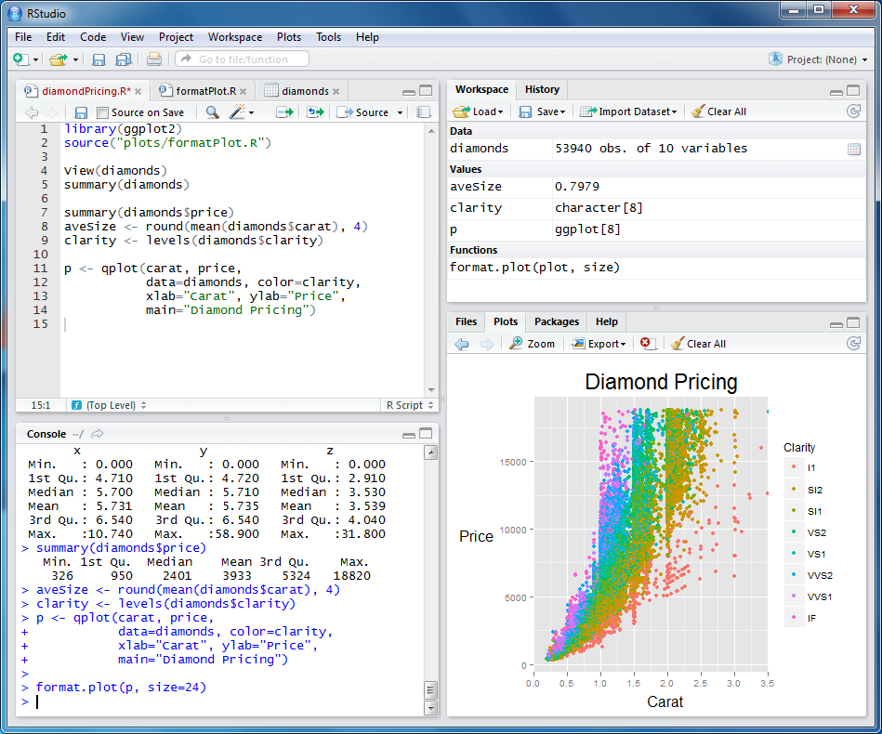
1. R and R-studio installation
Environment
Editor
Files/Plots/Packages
Console

Slide 6
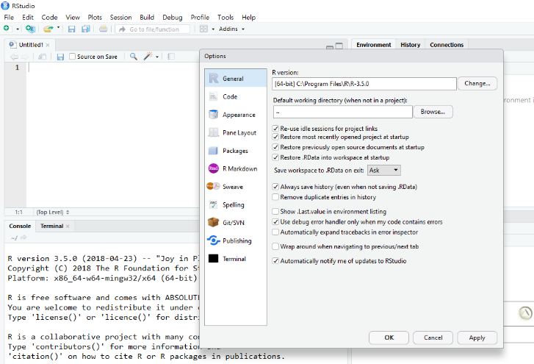
1. R and R-studio installation
Tools > Global options
Customize appearance

Slide 7
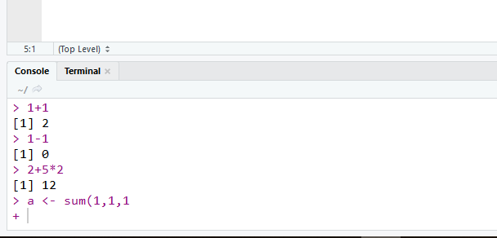
2. Basic computation and data format
R console can be used as a built-in calculator
Hash sign (#) is a comment character
> 2 + 3 #5
> 2 / 3 #0.6666667
> sqrt(36) #6
> log10(100) #2
“>” means R is ready to take new command
“+” means there is a incomplete command

Slide 8
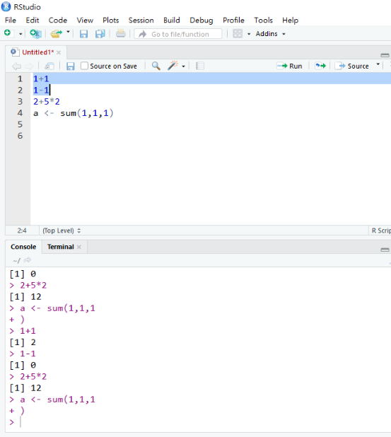

2. Basic computation and data format
To submit a line command
Way 1: highlight and hit Run
Way 2: highlight and hit
Ctrl + Enter (Windows)
Cmd + Return (Mac)
Way 3: directly type in console and hit Enter

Slide 9
2. Basic computation and data format
The assignment operator (“=“ or “<-”)
> A <- 10 #assign 10 to an object called “A”
> A = 10 #same
> 10 -> A #Wrong!
> 10 = A #Wrong!
> B <- "Hi"
> C <- c(1, 2, 3, 4, 5)
Do not confuse “=“ with “==” (i.e., logical operator)
> A == 10 #TRUE
> A == 20 #FALSE

Slide 10
2. Basic computation and data format
Common variable types
numeric: numbers such as 10, 3.14, etc.
characters: strings such as "Hi", "HiHi", etc.
logical: TRUE, FALSE
Use, for example, “is.numeric” to check
> is.numeric(A)
> is.character(A)
> is.logical(A)
> is.logical(is.logical(A)) #Think before you try this

Slide 11
2. Basic computation and data format
Common data types
vector: a collection of elements of the same type
matrix: all columns must contain the same variable type
data.frame: columns can contain different types of variables
list: can hold objects of different types and lengths
Use, for example, “is.vector” to check
> C = c(1, 2, 3, 4, 5)
> is.vector(C) #TRUE
> is.matrix(C) #FALSE

Slide 12
2. Basic computation and data format
Vectors
> V = c(1, 2, 3, 4, 5) #Use “c” which stands for ”combine”
> V = c("one", "two", "three") #A character vector
> V = 1:20 #Use “:” for continuous numbers
> V = seq(from=1, to=5, by=0.5) #Use function “seq”
> V = rep(5, times=10) #Use function “rep”
Elements within a vector will all belong to the same data type
> V1 = c(1, 2, 3, 4, 5)
> is.numeric(V1)
> V2 = c(1, 2, ”three", 4, 5)
> is.numeric(V2) #Think before you try this

Slide 13
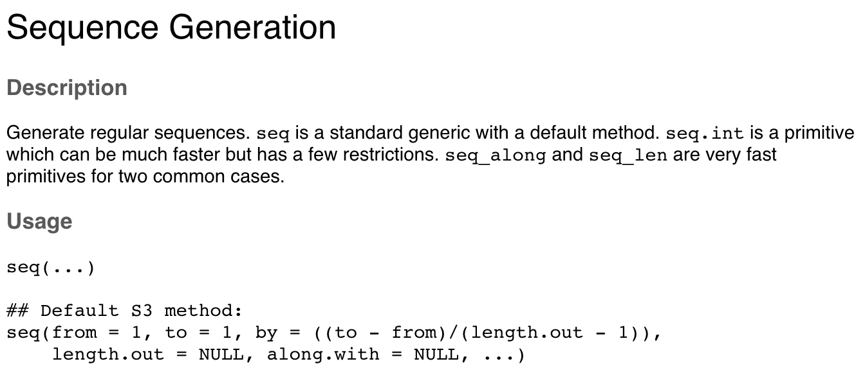
2. Basic computation and data format
Before we move on, know how to ask R questions!
Type “?seq” in the console

Slide 14
2. Basic computation and data format
Referencing elements of a vector based on position
> V = c(1:5, 7:9, seq(10, 50, by=10))
> V[1:3]
> V[c(1, 3, 5)]
> V[-2] #Negative indexing can be used to drop elements
> V[2] <- 1000 #Can replace original elements by assigning new values

Slide 15
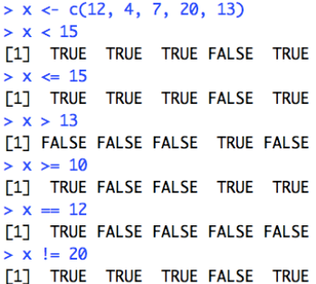
2. Basic computation and data format
Logical operators
such as: <, <=, >, >=, ==, !=
use “|” to represent “OR”
use “&” to represent “AND”
use “!” to represent “NOT”
Logical vectors
vectors of TRUE (1) or FALSE (0)

Slide 16
2. Basic computation and data format
Referencing elements of a vector based on logical operators
> V = c(1:5, 7:9, seq(10, 50, by=10))
> V > 6
> V[V > 6]
> want = V > 6
> V[want]
> which(V > 6)
> V[which(V > 6)] #Think about what’s within the brackets

Slide 17
2. Basic computation and data format
Some other exercises: sorting
> V = c(1, 5, 4, 2, 3)
> sort(V)
> order(V) #This gives you: 1, 4, 5, 2, 3
> V[order(V)]
Some other exercise: removing missing values
> V3 = c("a", "b", NA, "c") #This is a character vector
> is.na(V3) #This tells you whether it is NA or not
>!is.na(V3)
> V3.new = V3[!is.na(V3)]

Slide 18
2. Basic computation and data format
Some other exercises: vector arithmetic
> V = c(1, 5, 4, 2, 3, 6)
> V + 2
> V * 3
> V^V #Think before you try this
> v = c(1, 2) #R is case-sensitive
> V + v #Shorter vector is “recycled”
> mean(V)
> sd(V)
> sum(V) #Basic calculations

Slide 19
2. Basic computation and data format
Matrix
> M1 = matrix(1, nrow=3, ncol=3) #Use function “matrix”
> M2 = matrix(c(1:12), nrow=4, ncol=3, byrow=T)
Some matrix calculations
> M2 * 2 #Elementary-wise multiplication
> M3 = t(M2) #Transpose matrix
> M2 %*% M3 #Matrix multiplication
Referencing matrix values
> M2[1, 2] #Element at 1st row & 2nd column
> M[1, ] #All elements within the 1st row

Slide 20
2. Basic computation and data format
Data frame
> DF1 = data.frame(col1 = c(1, 2, 3, 4, 5),
+ col2 = seq(10, 50, by=10),
+ col3 = c("a", "b", "c", "d", "e"))
Referencing values within a data frame
> colnames(DF1) #Column names for the data frame
> DF1$col1 #Use “$” sign to index column names
> DF1[, 1] #You can still index based on position
> DF1[c(1, 3, 4), c(2, 3)]
> DF1[DF1$col3 == "b", ] #Think what’s in the bracket

Slide 21
2. Basic computation and data format
Some ways to append multiple data frames
> DF2 = data.frame(col4 = rep(9, times=5),
+ col5 = 2^c(1:5))
> DF1 = cbind(DF1, DF2) #Use “cbind” to add columns
> DF3 = data.frame(col1=6, col2=60, col3="f",
col4=9, col5=2^6)
> DF1 = rbind(DF1, DF3) #Use “rbind” to add rows
> DF1$col6 = 3^c(1:6) #Use “$” to create new columns
> DF1$col7 = DF1$col5 + DF1$col6

Slide 22
2. Basic computation and data format
Common functions that can be applied to data frames
> dim()
> nrow(); ncol()
> rownames(); colnames()
> head(); tail()
> View()
Common functions for vectors and columns of data frames
> max(); min(); range()
> mean(); sd()
> length(); summary()

Slide 23





2. Basic computation and data format
Exercises 1: BMI of Pokemon
Pikachu, Squirtle, Charmander, Bulbasaur, and Pidgey are pokemons with height 40, 50, 60, 70, and 30 cm, respectively, and with weight 6.0, 9.0, 8.5, 6.9, 1.5 Kg, respectively.
Create a data frame that records the name, height, and weight of these pokemons.
Create a new column within the data frame that records the BMI of these pokemons (BMI = Kg/(m^2)).

Slide 24
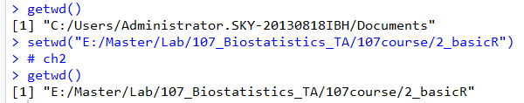
3. Data input and processing
First step, set working directory using command line
> getwd()
> setwd(“path to home folder”)
R uses “/” for file paths, which is different from Window’s “\”

Slide 25
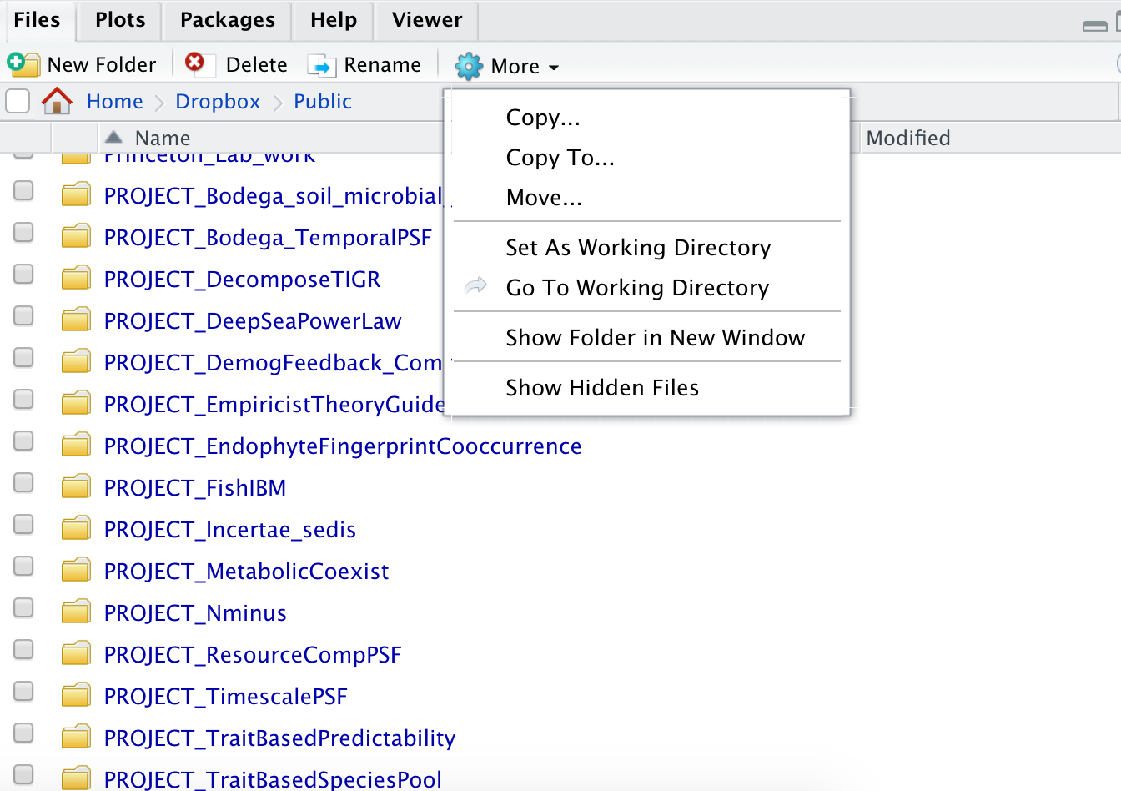
3. Data input and processing
Alternatively, set working directory using user interface
Go to “Files”, navigate to correct folder, click “More”

Slide 26
3. Data input and processing
R usually takes in .csv files or .txt files
The option “header=T” makes the first row as column names
> Data = read.csv("filename.csv", header=T)
> Data = read.table("filename.txt", header=T)
To output files, use write.csv() or write.table()
> write.csv(Data, file="mynewdata.csv")
> write.table(Data, file="mynewdata.txt")

Slide 27
3. Data input and processing
Exercise 2: read in data files and perform data screening
Set you local folder as the working directory, read in the file “example_dat.txt” and save it with the name “data”.
Inspect the data with commands mentioned in previous sections, e.g., summary(), head(), dim().
Chl.a shouldn’t be negative! Create a new data named “data_new” with those rows removed.
Look up the function “apply” using ?apply. Use the function to calculate the mean of all environment variables (i.e., columns 3-9).

Slide 28
4. Data visualization and plotting
Common plotting commands
plot(x, y, data)
plot(y~x, data)
hist(x) (Histogram)
barplot() (Barplot)
boxplot() (Boxplot)
Plot one single variable using “plot(x)”
> plot(data_new$Chl.a.)

Slide 29
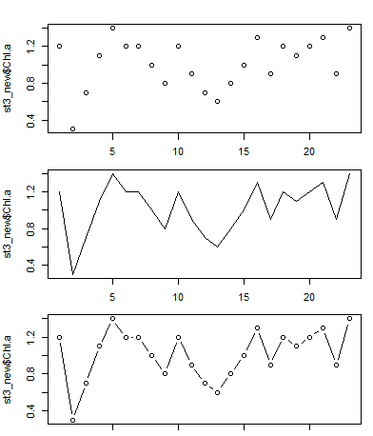
4. Data visualization and plotting
Different ‘type’ within the plot function
> plot(data_new$Chl.a., type=‘p’) #points
> plot(data_new$Chl.a., type=‘l’) #lines
> plot(data_new$Chl.a., type=‘b’) #both

Slide 30
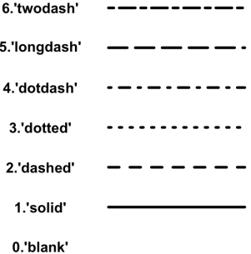
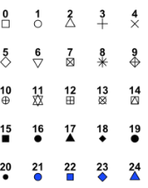
4. Data visualization and plotting
Common plotting arguments
main: plot title
xlab, ylab: x- and y-axis labels
xlim, ylim: x- and y-axis range
lty: line type
lwd: line width
pch: point symbol
cex: symbol/font size
col: symbol/font/line color

Slide 31
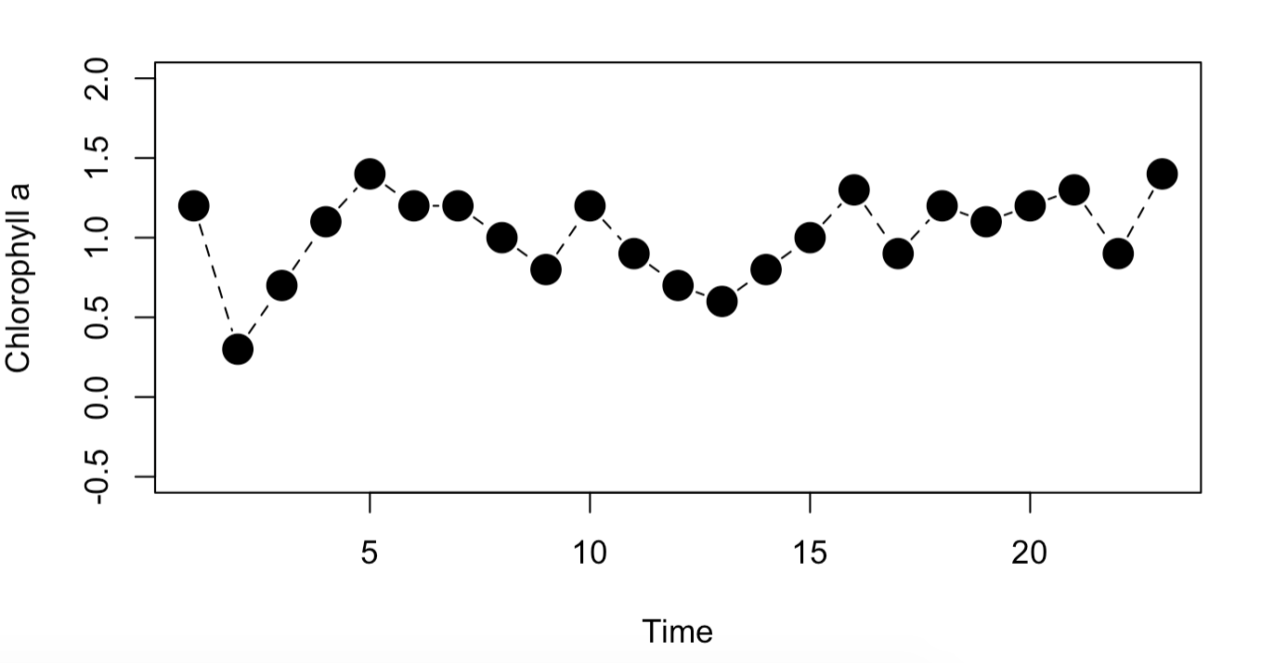
4. Data visualization and plotting
Use plotting arguments to improve your figure
> plot(data_new$Chl.a., type='b', xlab="Time",
ylab="Chlorophyll a", ylim=c(-0.5, 2),
lty=2, pch=19, cex=2)

Slide 32
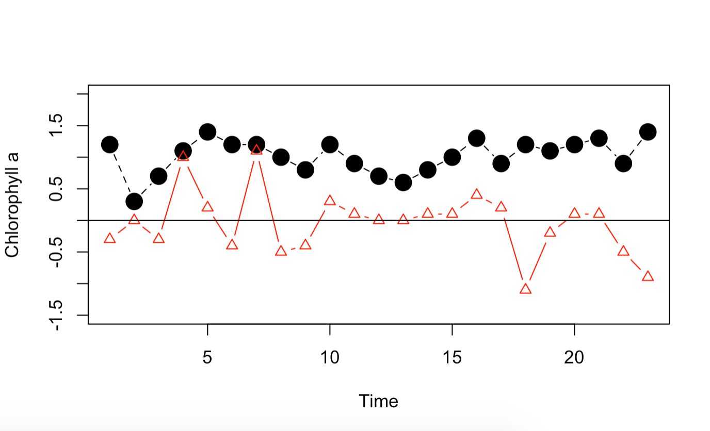
4. Data visualization and plotting
Adding data to an existing plot
points: add points
ablines: add lines
title: add title
text: add text
legend: add legend
> plot(data_new$Chl.a., type='b', xlab="Time", ylab="Chlorophyll a", ylim=c(-1.5, 2), lty=2, pch=19, cex=2)
> points(data_new$PhycEth, type='b', lty=1, pch=2, col="red")
> abline(h=0, lty=1)

Slide 33
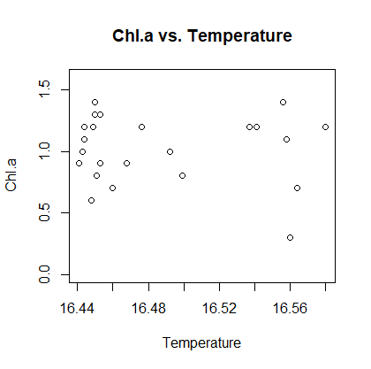
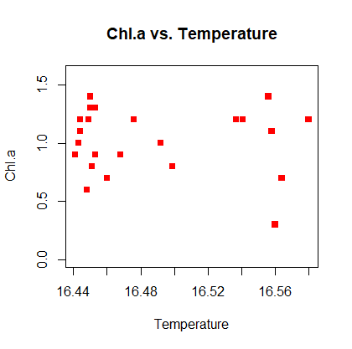
4. Data visualization and plotting
Plot the relationship between two variables: plot(y~x)
> plot(Chl.a.~Temp, data=data_new, main="Chl.a vs. Temperature", xlab="Temperature", ylab="Chl.a", ylim=c(0, 1.6))
> plot(Chl.a.~Temp, data=data_new, main="Chl.a vs. Temperature", xlab="Temperature", ylab="Chl.a", ylim=c(0, 1.6), pch=15, col="red")

Slide 34
5. Create your own function
Basic form: name <- function(arguments){action}
> myfunc <- function(x, y){sqrt(x^2 + y^2)}
> myfunc(3, 4) #5
> mysd <- function(x){sqrt(sum((x-mean(x))^2)/(length(x)-1))}
> mysd(data_new$Chl.a.) #0.2774104
> sd(data_new$Chl.a.) #Compare with sd()
> myplot <- function(n){
+ x = 0:n
+ y = x^2
+ plot(y~x, type='l’)
+ }
> myplot(10) #Plot quadratic function

Slide 35
5. Create your own function
for-loops: for(variable in min:max){action}
if-statements: if(criterion){action}
> for(i in 1:5){
+ if(i <= 2){print(i * 10)}
+ if(i > 2){print(i)}
+ }

Slide 36
5. Create your own function
Exercise 3: classifying data based on values
Add a new column in the data data_new, named “category”. The value of this column is 1 if turbidity is less than 10, 2 if between 10 to 15, and 3 if turbidity is greater than 15

